Slide 1

CIS 4496 Individual learnings NLP Disaster Tweets
Arun Agarwal

Slide 2

Business Problem
Twitter: important communication channel in times of emergency
Ubiquitousness of smartphones → anyone to announce an emergency at any time
Disaster Relief Organizations and News Agencies need to programmatically monitor Twitter
Problem: Twitter isn’t all credible
Slang, metaphors, homonyms, source
A human may understand but what about a machine?

Slide 3

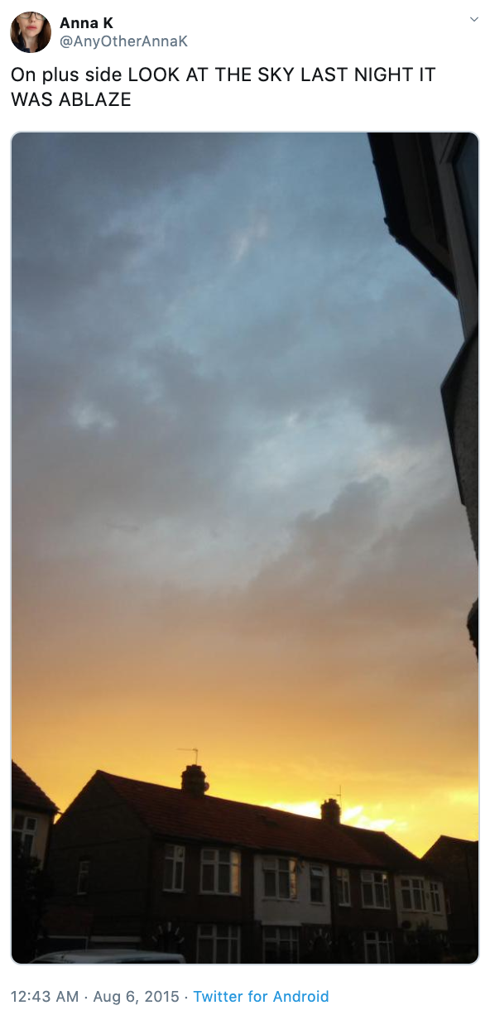
Competition Introduction
“Getting Started” Competition
NLP and Preprocessing
Competition Goal: build ML model to distinguish between real and fake disaster tweets
Personal Goal: Learn NLP preprocessing techniques

Slide 4



Data
Data gathered by Figure-Eight Website and uploaded to Appen as pre-labeled dataset
10,000 hand-classified tweets
3 files: train, test, sample_submission
id: identifier for each tweet
text: the tweet
keyword: keyword from tweet (many blank)
location: location sent from (many blank)
target: disaster (1) or not (0)

Slide 5

Workflow
Explored Competition/Problem/Data
Completed Tutorial
Looked into previous team’s work
Looked into Other competitor’s work
Setup GitHub repo
Performed EDA
Performed Text Preprocessing
Created Features
Scaled Data
Built Logistic Regression Model
Found Deep Learning Model to Use
Setup code to run on HPC
Setup code to run on Kaggle
Writing Data and Model Performance Reports
Organizing GitHub
Notes:
15 Weeks → 15 Steps

Slide 6


Preprocessing Steps
Found list of abbreviations online
Lowercase everything
Remove emojis and special characters
Remove punctuation (EDA decision)
Expand contractions
Remove URLs (EDA decision)
Replace slang, informal abbreviations, and acronyms
Manually cleaning (typos, hashtags, usernames)
Find and manually deal with mislabeled samples
Remove duplicate instances
Remove additional whitespace at end
Notes:
hashtags and usernames contain lots of information about the context but they are written without spaces in between words so they don't have embeddings. Informational usernames and hashtags should be expanded but there are too many of them. I expanded as many as I could

Slide 7

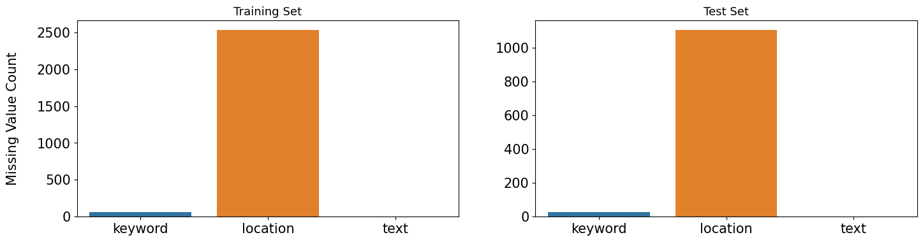
EDA – Missing Values
Distributions of missing values for each column in training and test datasets

Slide 8
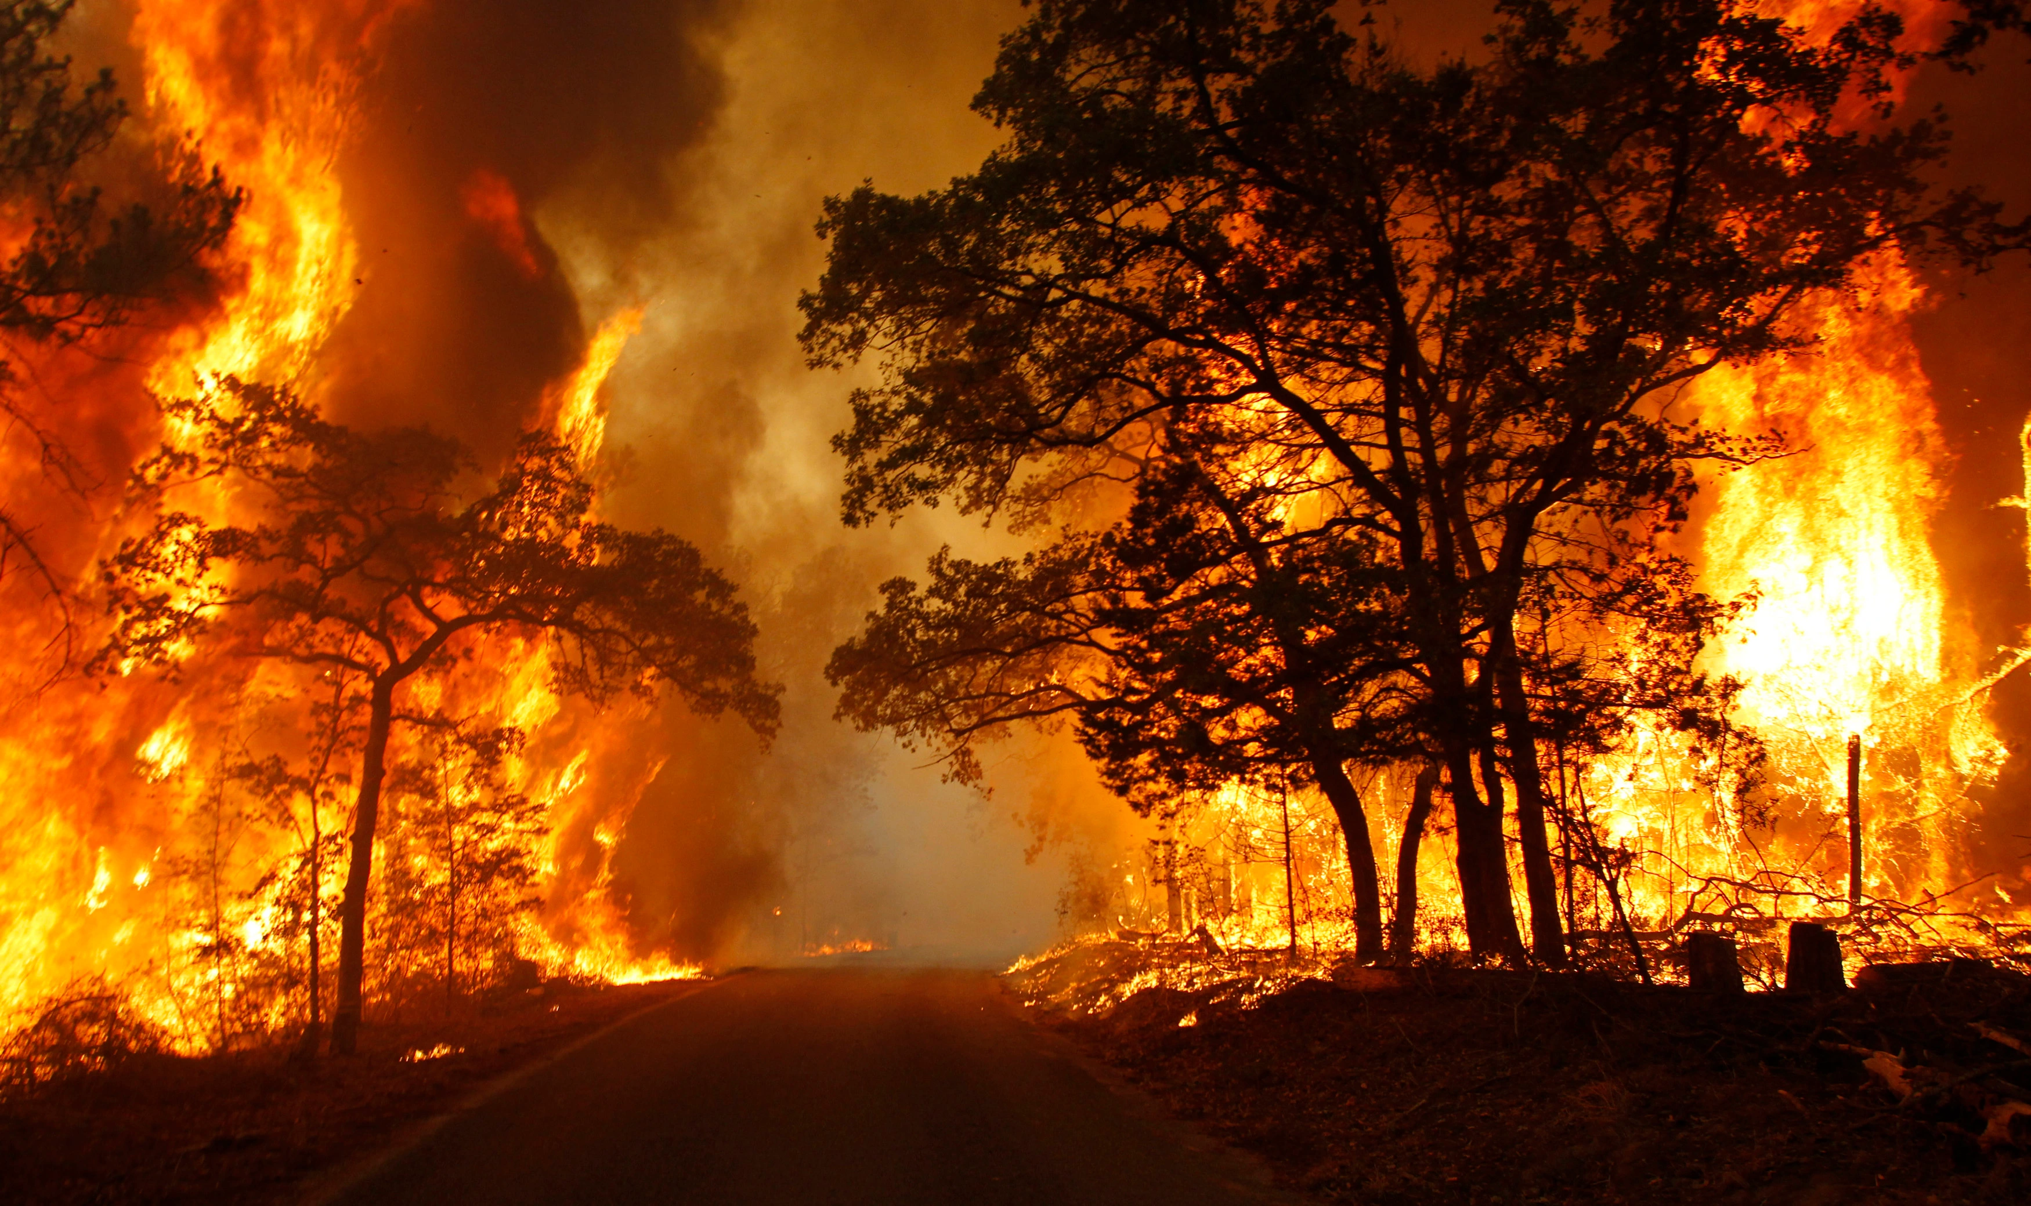
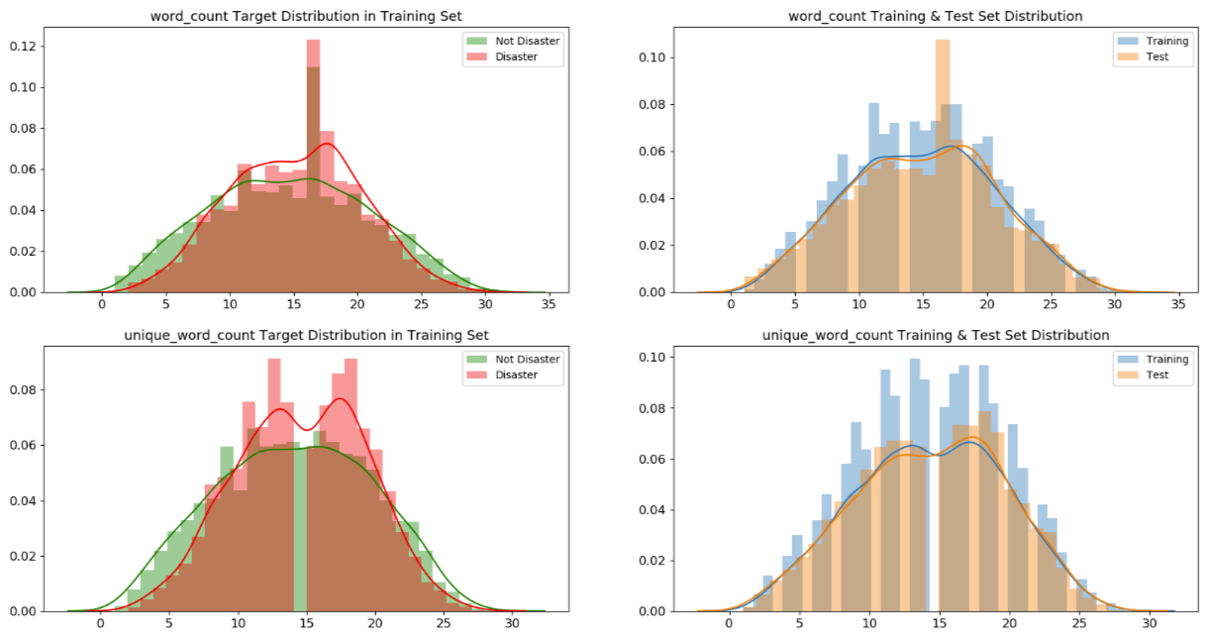
EDA – Target Distributions (Sample)
Distributions of two of created features, broken down by target variable and by training/test set
Notes:
All of the meta features have very similar distributions in training and test set which also proves that training and test set are taken from the same sample.
All of the meta features have information about target as well, but some of them are not good enough such as url_count, hashtag_count and mention_count.
On the other hand, word_count, unique_word_count, stop_word_count, mean_word_length, char_count, punctuation_count have very different distributions for disaster and non-disaster tweets. Those features might be useful in models.

Slide 9
Baseline Model → Final Model
NOTE: did not get score for test data for initial models because was running code locally while still in preprocessing phase
Since data came from same source, it is fine
Baseline Model (Tutorial):
No preprocessing
Count Vectorizer
Linear Model (Ridge Classifier)
No Parameter Tuning
3-Fold Cross Validation
F1 Scores: 0.594, 0.565, 0.641 → 0.60
Second Model (Logistic Regression):
Some preprocessing
Features Created as Input to Model
Instead of text
Logistic Regression Model
No Parameter Tuning
F1 Score: 0.546
Final Model (DL):
All preprocessing
Tokenization (FullTokenizer)
2-Fold StratifiedKFold
Features Created not Inputted
BERT Model Implementation from TensorFlow
L = 12 hidden layers
H = 768 hidden size
A = 12 attention heads
Uncased inputs
F1 Score: 0.812
Notes:
Mislabels and duplicates still in: Scores: [0.61169102 0.54718876 0.60039761]
Mislabels in but no duplicates: Scores: [0.5789153 0.53946621 0.59375]
No Mislabels but duplicates still in: Scores:[0.62434418 0.54313425 0.62040816]
No Mislabels and no duplicates: Scores: [0.5767098 0.53946621 0.5949214]
A transformer is a deep learning model that adopts the mechanism of self-attention, differentially weighting the significance of each part of the input (which includes the recursive output) data. It is used primarily in the fields of natural language processing (NLP) and computer vision (CV). Allows for parallel processing
Tokenization is used in natural language processing to split paragraphs and sentences into smaller units that can be more easily assigned meaning
Done using FullTokenizer class from tensorflow/models/official/nlp/bert/tokenization.py
KFold is a cross-validator that divides the dataset into k folds. Stratified is to ensure that each fold of dataset has the same proportion of observations with a given label. Great for classification problems where we want the ration between target classes to be same in each fold as it is in full dataset
Using an implementation of BERT from TensorFlow Models: tensorflow/models/official/nlp/bert
Bidirectional Encoder Representations from Transformers is a family of masked-language models which is used to help computers understand the meaning of ambiguous language in text by using surrounding text to establish context
Uncased inputs (accents removed and text lowercased before tokenization)

Slide 10
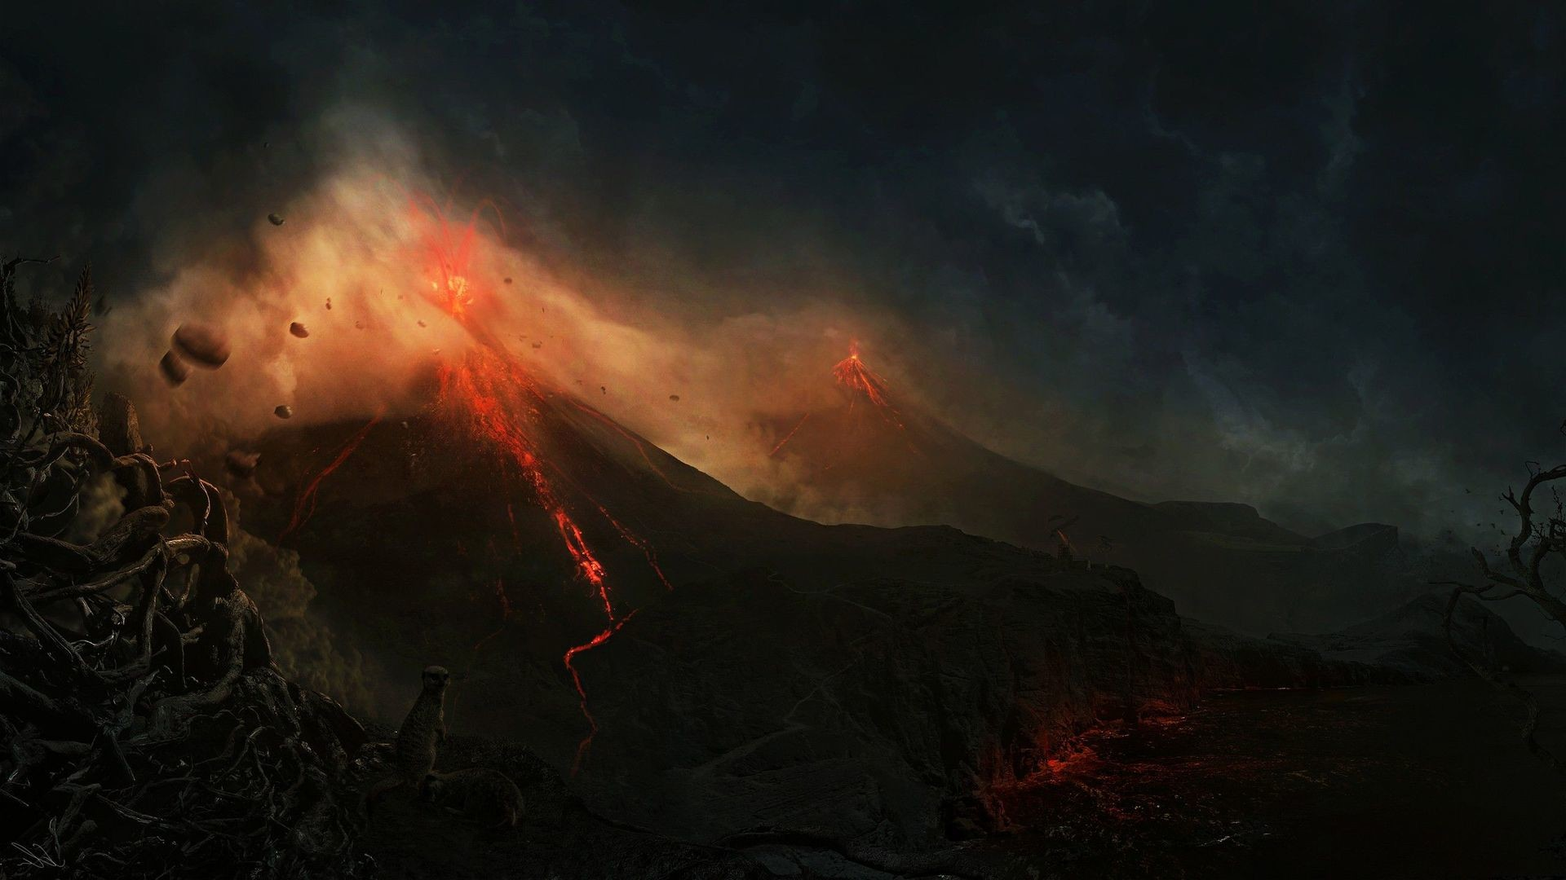
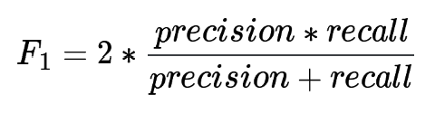
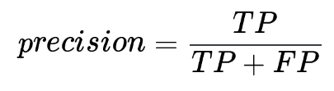
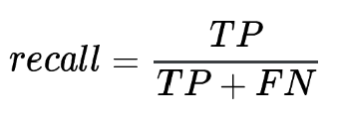
Performance Evaluation
Performance measured using F1 Score
Two month rolling window for submissions
Best Scores in mid 80s
311th/1228 → ~25th percentile
Test set labels publicly available, so perfect submissions on leaderboard
Doesn’t really matter though because this competition has no prizes
Only one leaderboard (no separation between private and public)

Slide 11
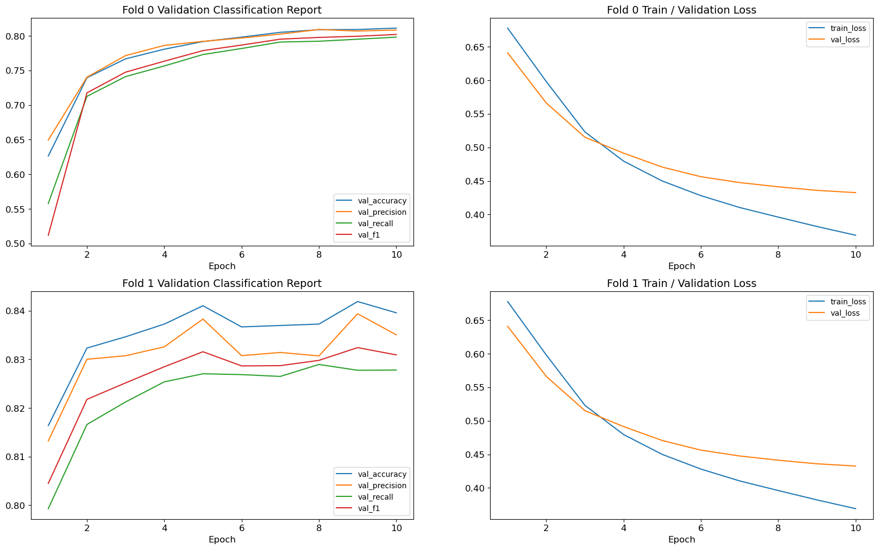
Charts of Validation Accuracy, Precision, Recall, and F1 for 2 Folds Over 10 Epochs (Left)
and Charts of Train and Validation Loss for 2 Folds Over 10 Epochs (Right)

Slide 12

Challenges
Time
2-3 hours/week
Runtime Limits
Kaggle: TPU overflow
GPU worked?
CPU: running would have to be overnight and would sometime time-out
Hard to experiment with different approaches
Back Translation
Feature Creation
Other Dataset Versions
Different Deep Learning Models

Slide 13
Learnings
Various ways to preprocess and think about text data
New ideas on how EDA can help us learn the data and how to preprocess it
Checking missing value distributions for each column and target distributions in train and test → data from same source
Location column → realization that can’t be auto-generated (user-input) → too unique/not helpful
Meta features distributions → realization that are real disasters are written with more formal language/longer words and less typos

Slide 14

Potential Future Steps
Back Translation
Input Features Created into Model
Try Other Dataset Versions
Try Different Deep Learning Models
Organize GitHub and Code Further
Notes:
XLNet, RoBERTa, ALBERT

Slide 15
References
NLP Disaster Tweet Data Source
NLP Disaster Tweet Kaggle Competition
Gunes Evitan Kaggle Competitor Code
Previous Group GitHub
Transformers Modeling BERT
How To Train a BERT Model - Towards Data Science
GitHub NLP Tokenization Code
My GitHub Repository

